Slide 1
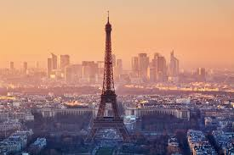
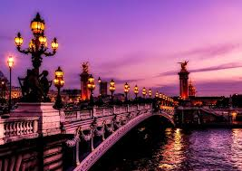
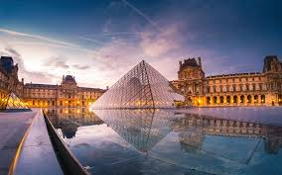
Capstone Project - The Battle of Neighborhoods (Week 2)
How to choose the best hotel in Paris and nearby areas?

Slide 2
I. Business Problem Section
Being one of the world capitals of arts, culture, gastronomy and fashion, millions of travelers visit Paris each year to explore the city's cultural attractions. There are a lot of travel agencies that offer various deals on flights, hotel stays and rental cars. Also, there are people who prefer not to work with a travel agency and who want to plan the holiday on their own.
In this scenario, the business problem I am trying to solve is: How could I provide support to different stakeholders (people or tourism agencies) in choosing the best accommodation? Where would I recommend that is the best place to stay?
To solve this business problem, we will use Foursquare location data and we will create machine learning models to cluster Paris and nearby areas neighborhoods in order to recommend profitable hotels based on different surrounding facilities such as venues, restaurants, stores, attractions and so on.
Through these models the stakeholders will have a wide range of recommendations for accommodation, they will know all the facilities to enjoy on vacation, will receive a wide range of options and, in this way, they will know exactly what hotel is the most suitable for them.

Slide 3
II. Data Section
To perform this idea, it was used data from 2 different sources. Data about hotels from Paris and nearby areas was taken from: https://www.accorhotels.com. It was collected information related to postal code, name of the hotel, address and it was integrated into a database which contain 40 observations about 40 hotels from Paris and nearby areas. For a better analysis it was selected data about hotels from different areas and with different facilities.
The second source used is Foursquare location data in order to explore and target recommended locations across different venues.
The final database which combine Foursquare location data and Paris + nearby areas hotels data, will be used to develop our machine learning models and to cluster Paris + nearby areas neighborhoods in order to provide the best recommendations in choosing a hotel based on a wide range of surrounding facilities.

Slide 4
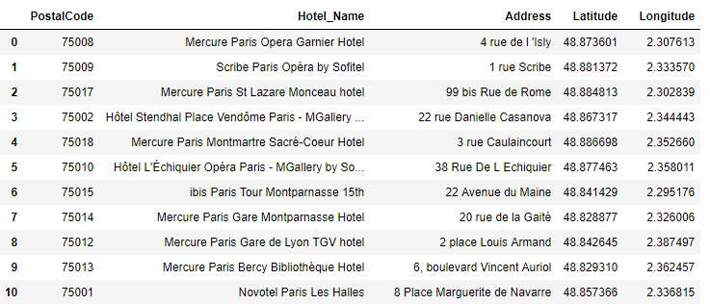
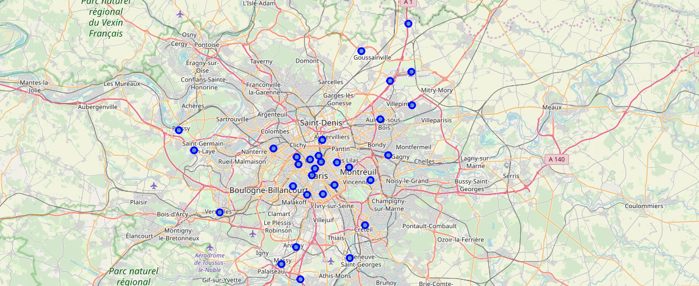

Slide 5
III. Methodology section
The main components of the report are:
1. Data Collection: to bring all the required information in one single data frame
2. Data Exploration and Understanding: to inspect the data, extract and analyze all the hidden insights
3. Data Modeling: K-means Clustering: to cluster Paris and nearby hotels to see how they group together and based on what kind of information with the final purpose to provide useful information related to accommodation strategies

Slide 6
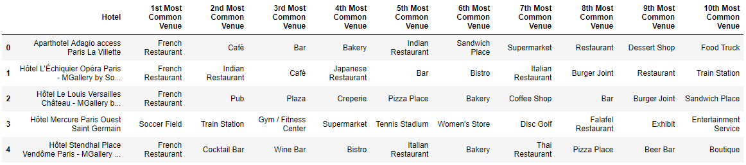
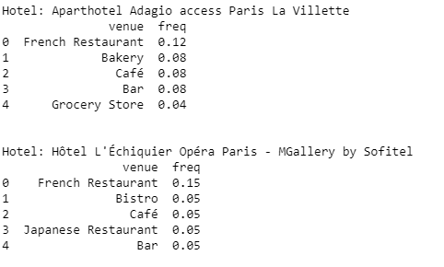
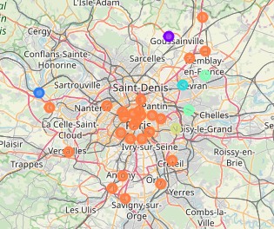

Slide 7
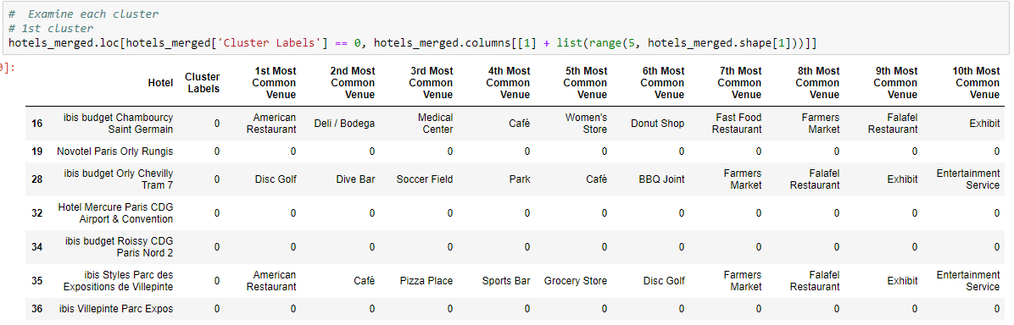
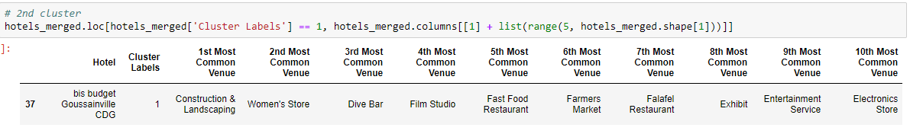
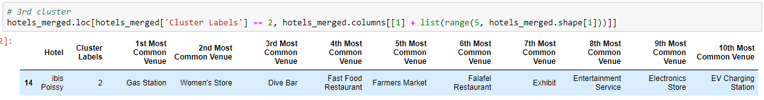

Slide 8
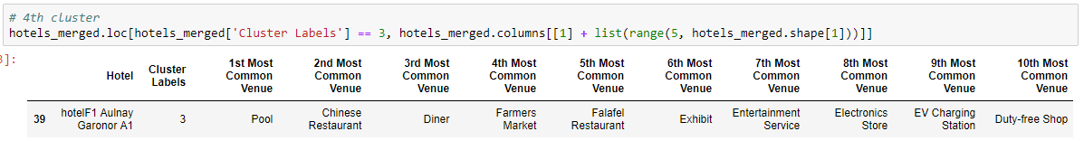
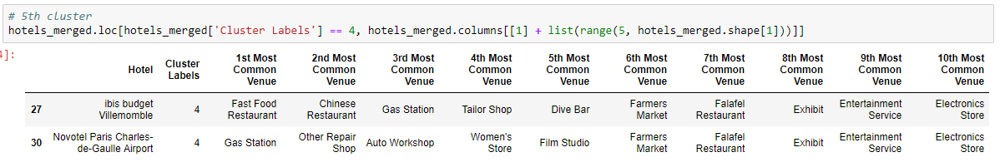
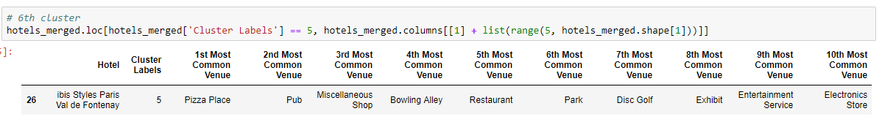

Slide 9
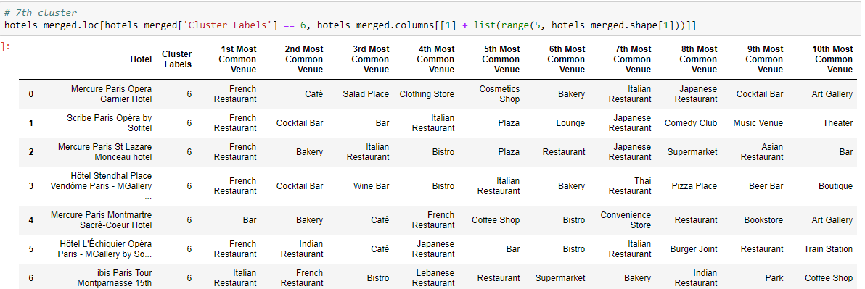

Slide 10
IV. Result Section
It was observed what venues are available near each hotel. Hotels that are in the center of Paris have the most facilities. Compared to the hotels located further from the center. There is a huge variety of facilities from local and foreign restaurants, airport services, art gallery, art museum, bus and trail station, shops, church, comedy club, grocery stores, market to medical center, museum, nightclub, park, theater and many others. Hotels from central area have in particular facilities, such as: local and foreign restaurants, bistro, cafe, bar, bakery, stores, plaza, lounge, along with the biggest tourist attractions: The Eiffel Tower, Louvre Museum, Notre Dame de Paris, Pantheon, Arc de Triomphe.
The map and the last 7 tables show the cluster grouping mode. The clusters were grouped by similarities. It can be noticed that hotels with common venues and many tourism attractions are grouped together, compared with hotels located in less crowded areas and with fewer facilities and venues. The largest cluster, the last one, contains the most number of hotels. They have the largest number of facilities and benefit of many tourist attractions.

Slide 11
V. Discussion Section
The cost of accommodation varies according to region and type. While hotel rooms are inevitably more expensive in Paris, there are also many interesting hotels nearby Paris.
It is interesting to note that, although the hotels in the center of the Paris might be considered very expensive due to all the surrounding facilities, hotels nearby the center have also a wide range of facilities and tourist attractions: Parc des Expositions, Rolland Garros, Palace of Versailles, Stade de France, Parc de la Villette and so on.
Although, all the clusters have an optimal range of facilities, I have found two main patterns. The first pattern I am referring to, clusters 0, 1, 2, 3, 4, and 5, highlights the hotels that have a smaller number of facilities and are located in less crowded areas. Instead, the second pattern, cluster 6, highlights the hotels that have the largest number of facilities and benefit of many tourist attractions.

Slide 12
VI. Conclusion Section
To solve this business problem, we clustered hotels from Paris and nearby areas in order to recommend venues and to support people who are looking for the right hotel to take the best decisions.
In conclusion, Paris offers a wide range of tourist attractions: food, fashion, culture, nature, art and so on. If someone wants to travel there are many things to consider from choosing the right location, accommodation, flights, rental cars to attractions, restaurants, stores and other facilities. The price of accommodation depends on the number of venues and surrounding facilities. The closer the hotel is to the tourist attractions, the more expensive it will be. However the analyzes show that there are very good hotels at a very short distance from the center and that it is not necessarily mandatory to stay in the city center to visit the most beautiful attractions.

